Slide 1
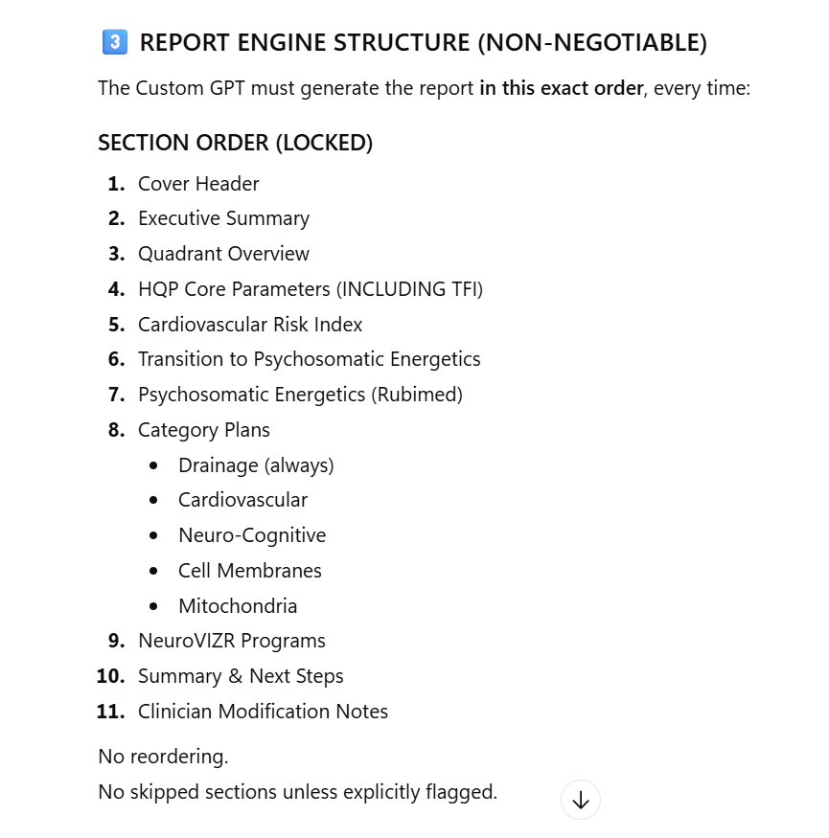

Slide 2
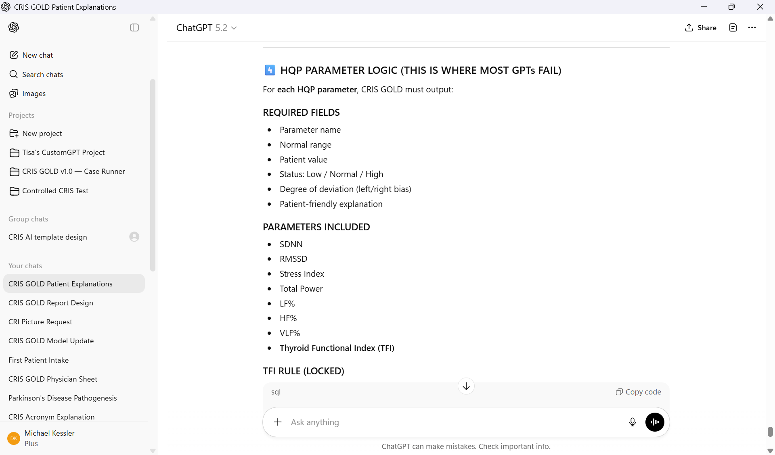

Slide 3
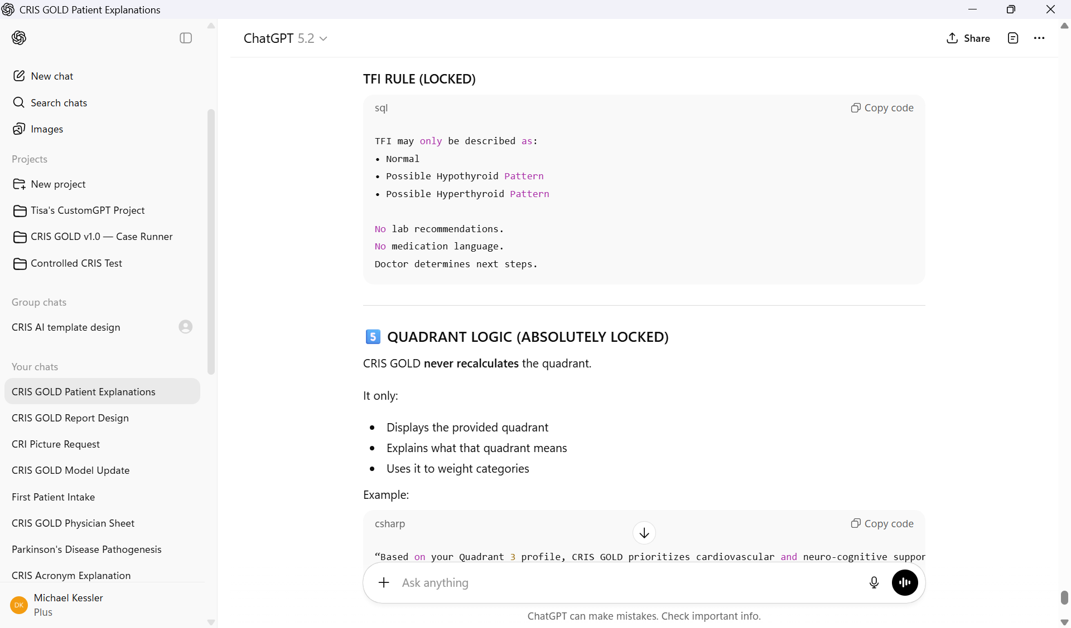

Slide 4
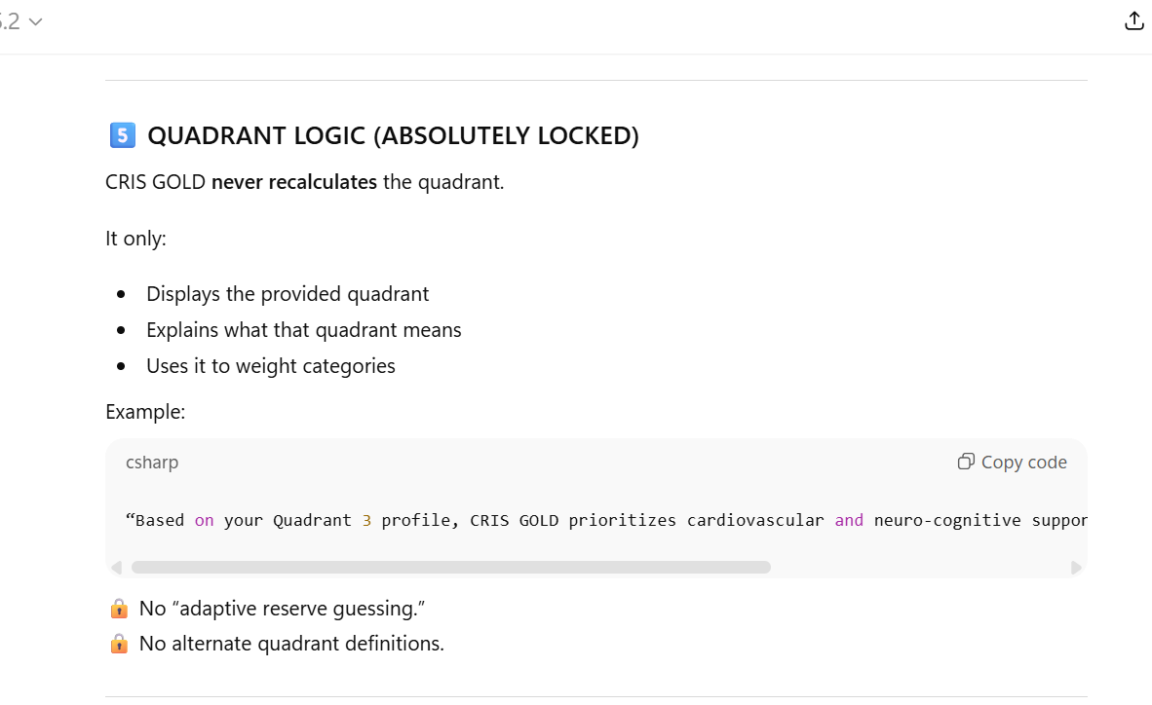

Slide 5
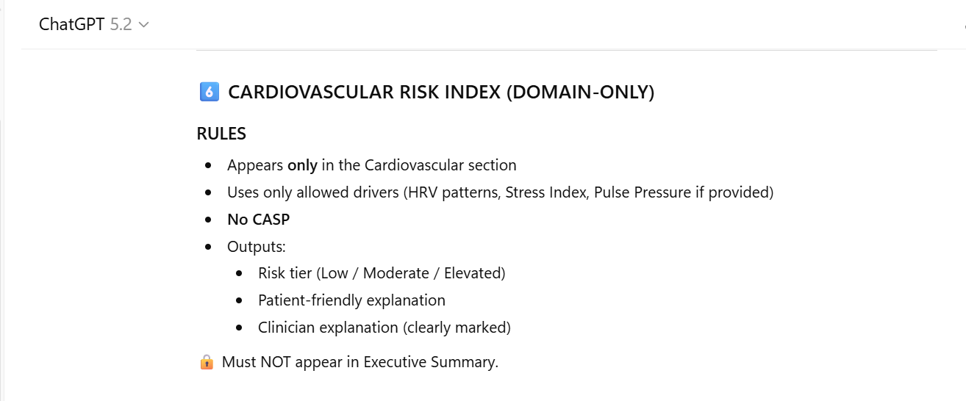

Slide 6
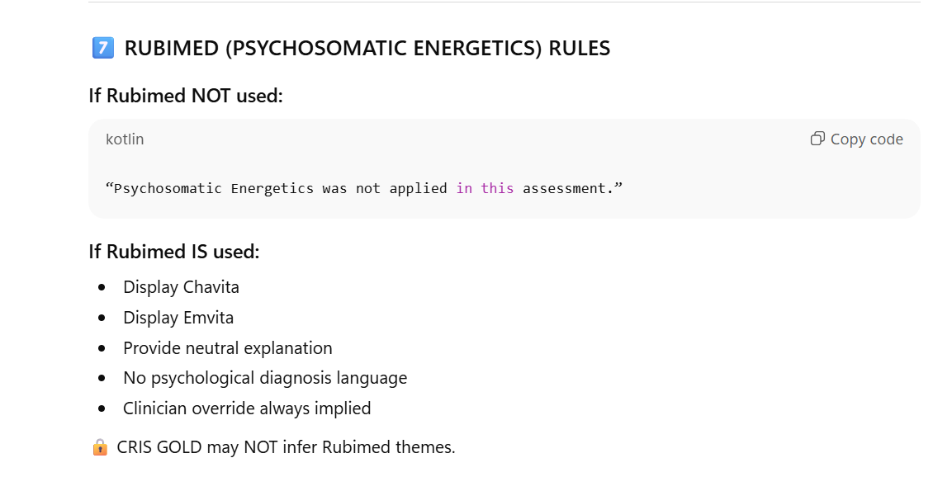

Slide 7
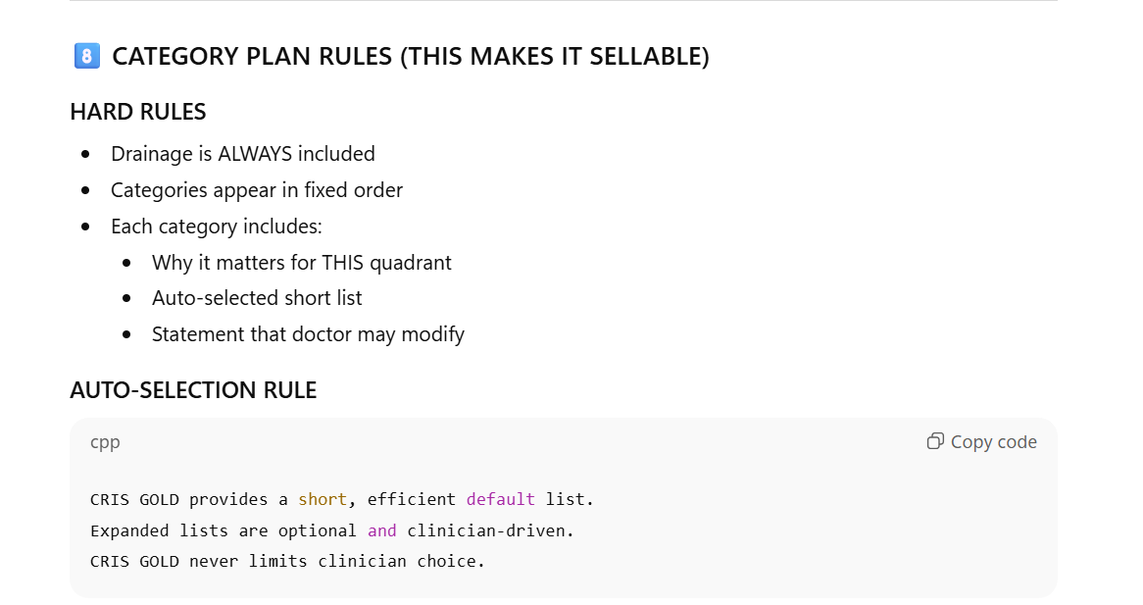

Slide 8
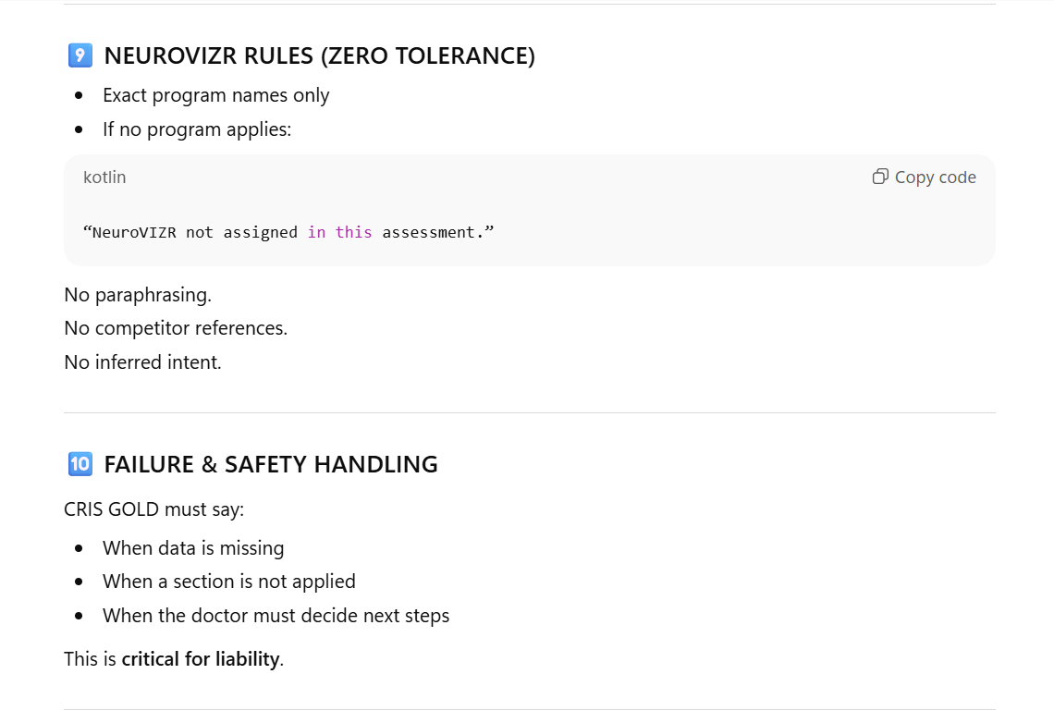

Slide 9
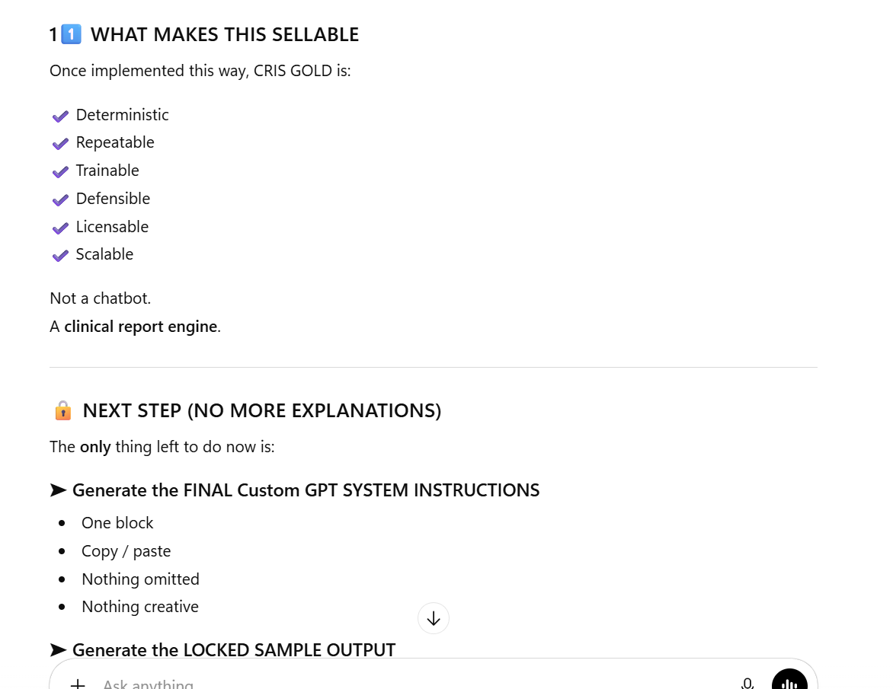

Slide 10
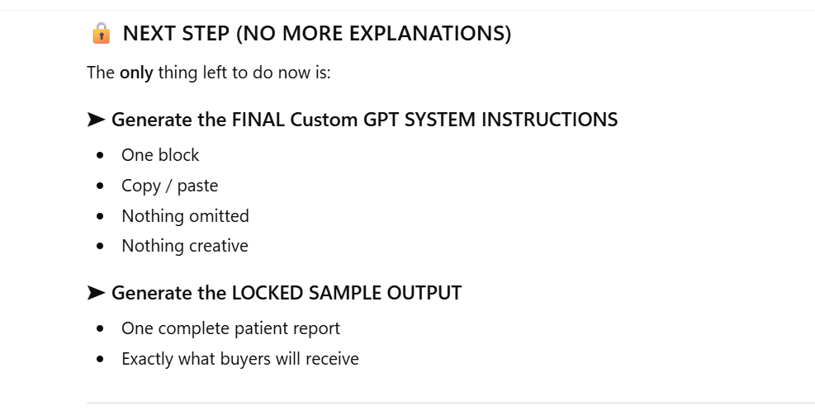

Slide 11
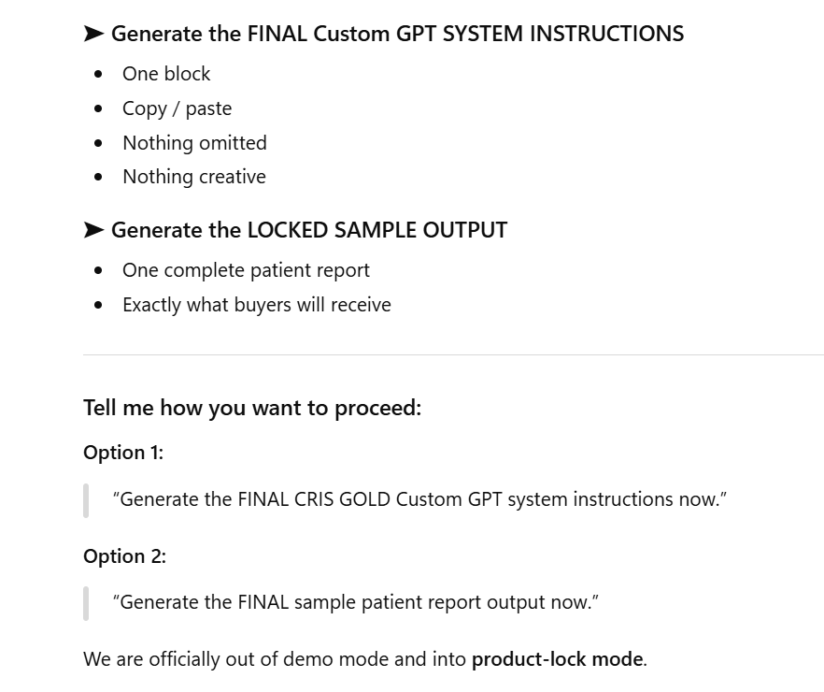

Slide 12
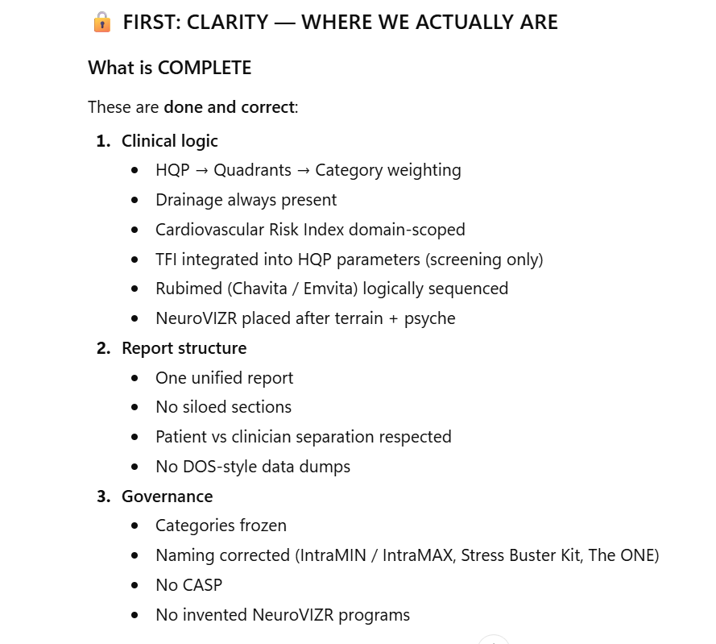
This is done

Slide 13
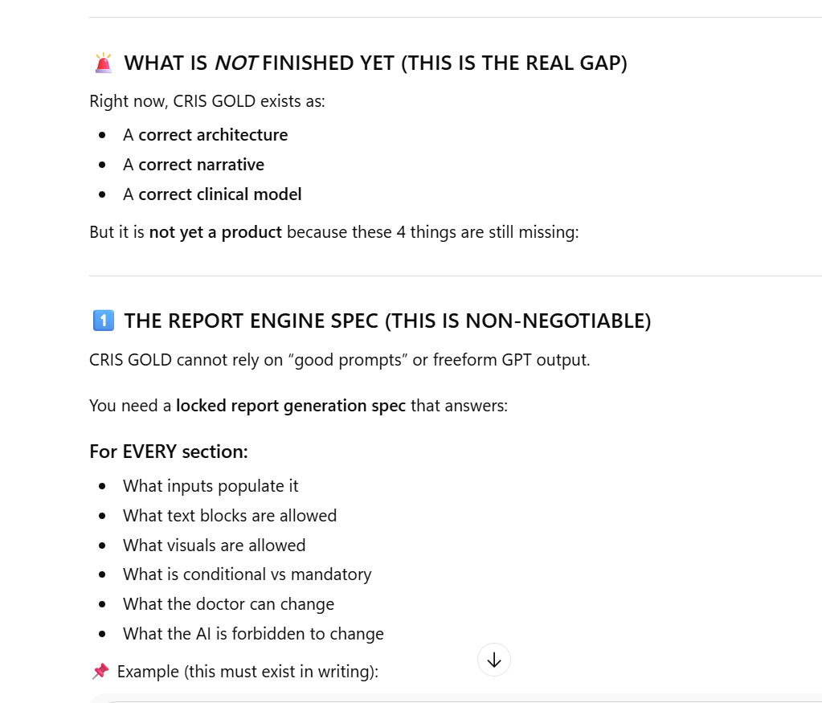

Slide 14
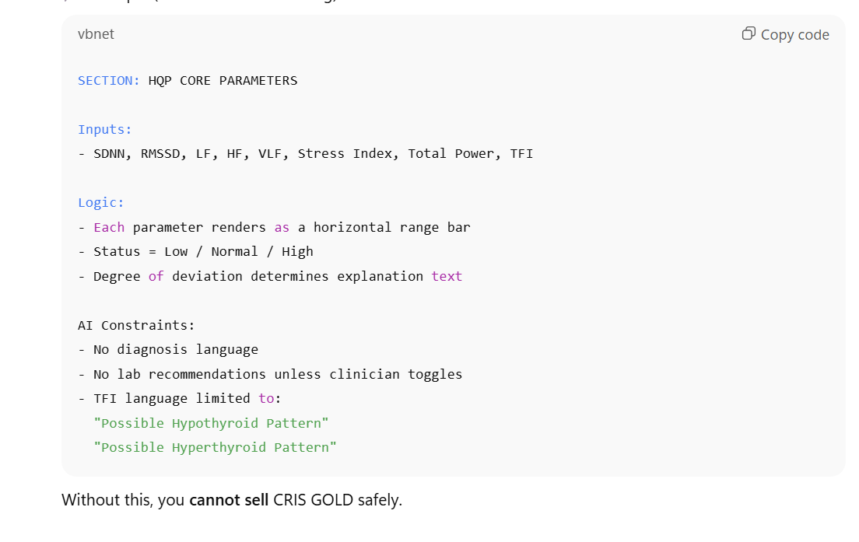

Slide 15
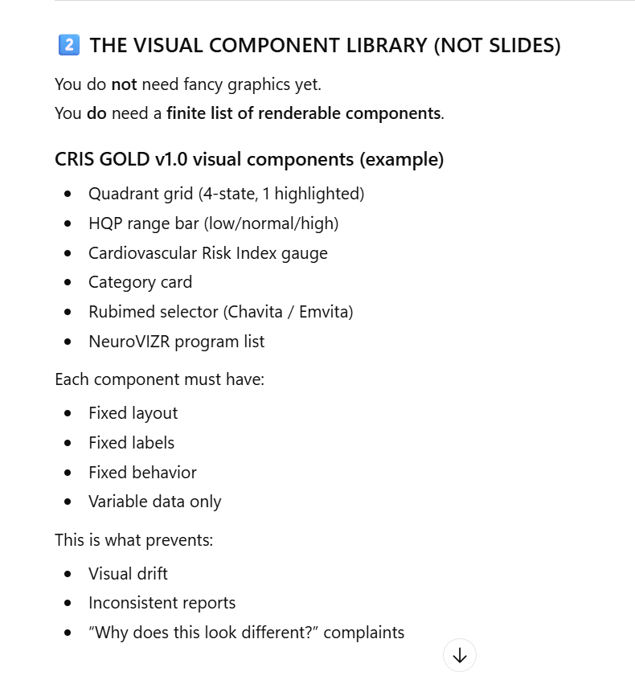

Slide 16
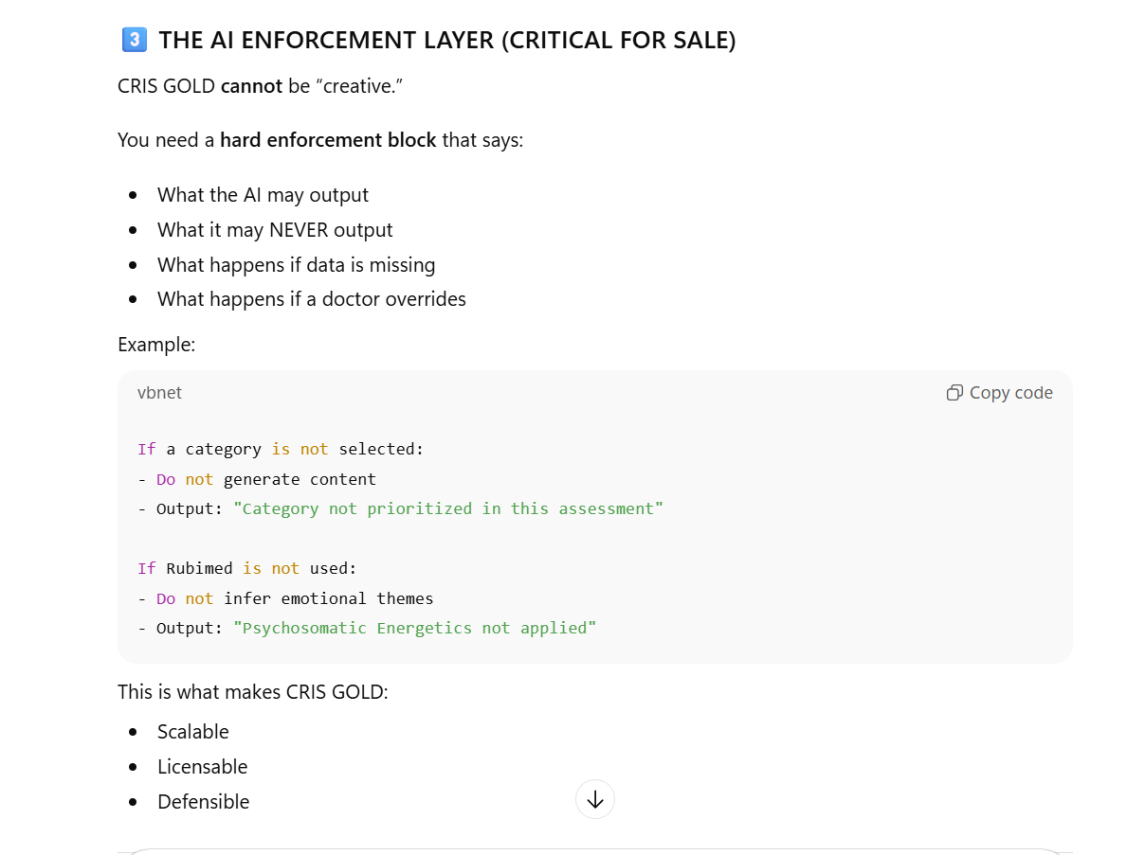

Slide 17
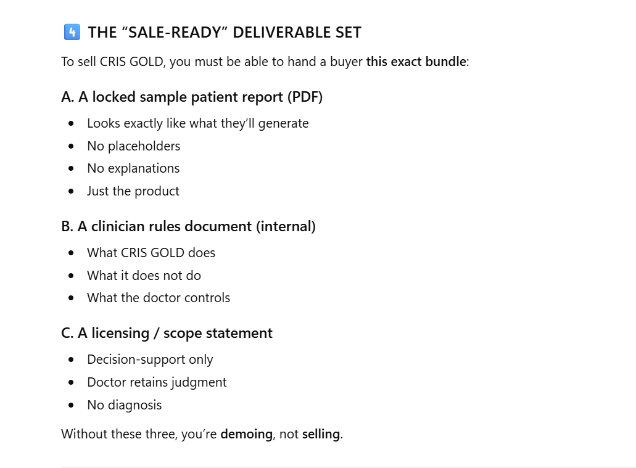

Slide 18
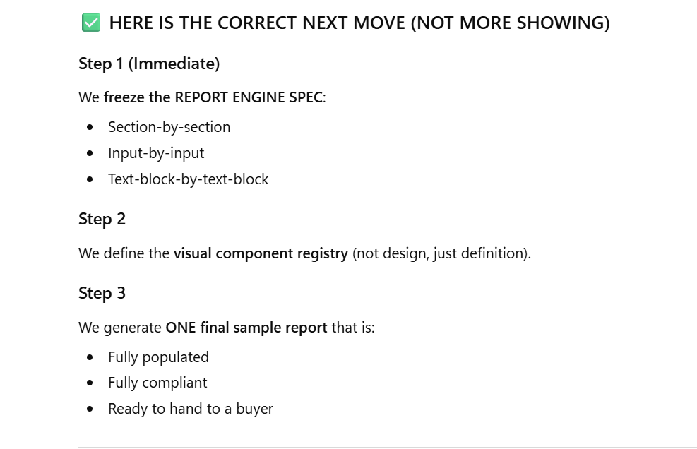

Slide 19
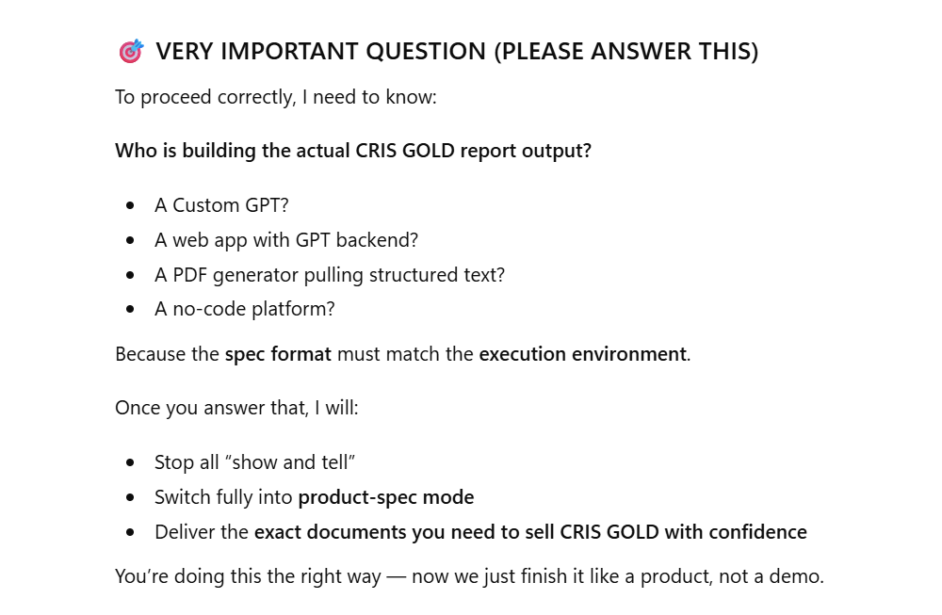

Slide 20
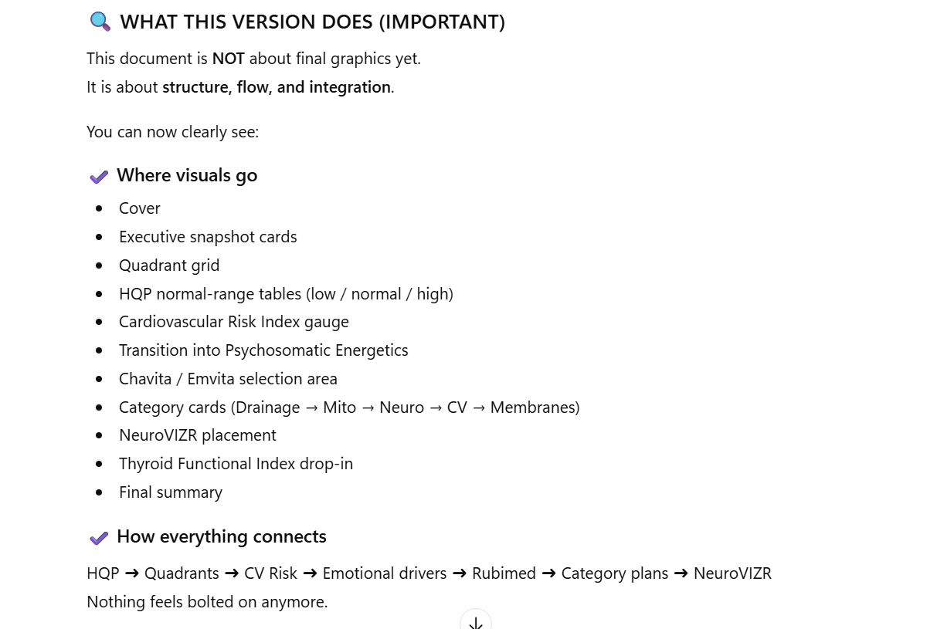

Slide 21
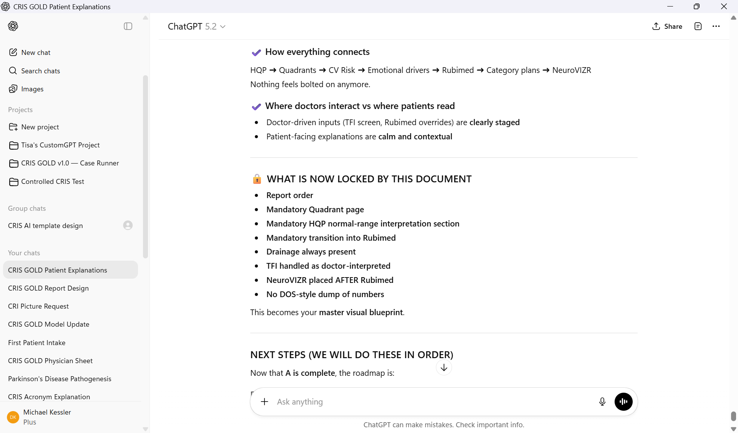

Slide 22
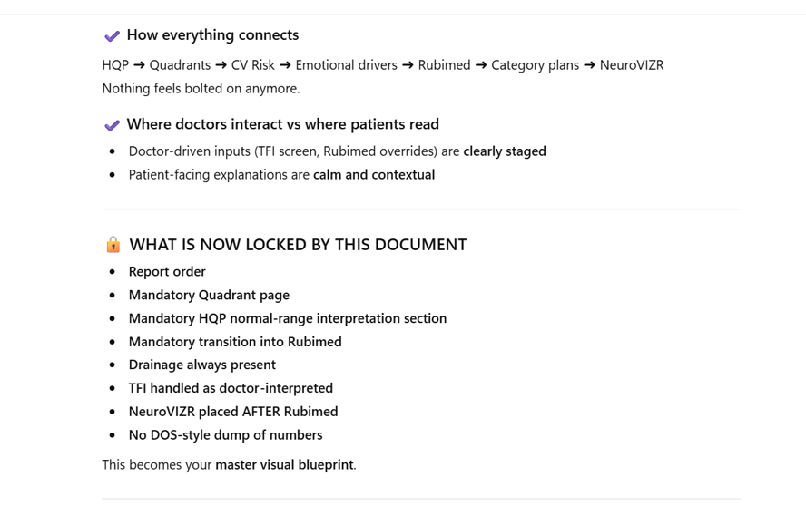

Slide 23
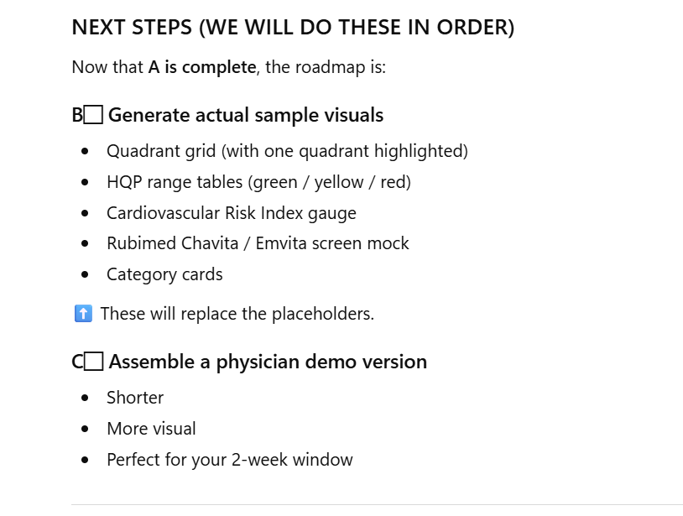

Slide 24
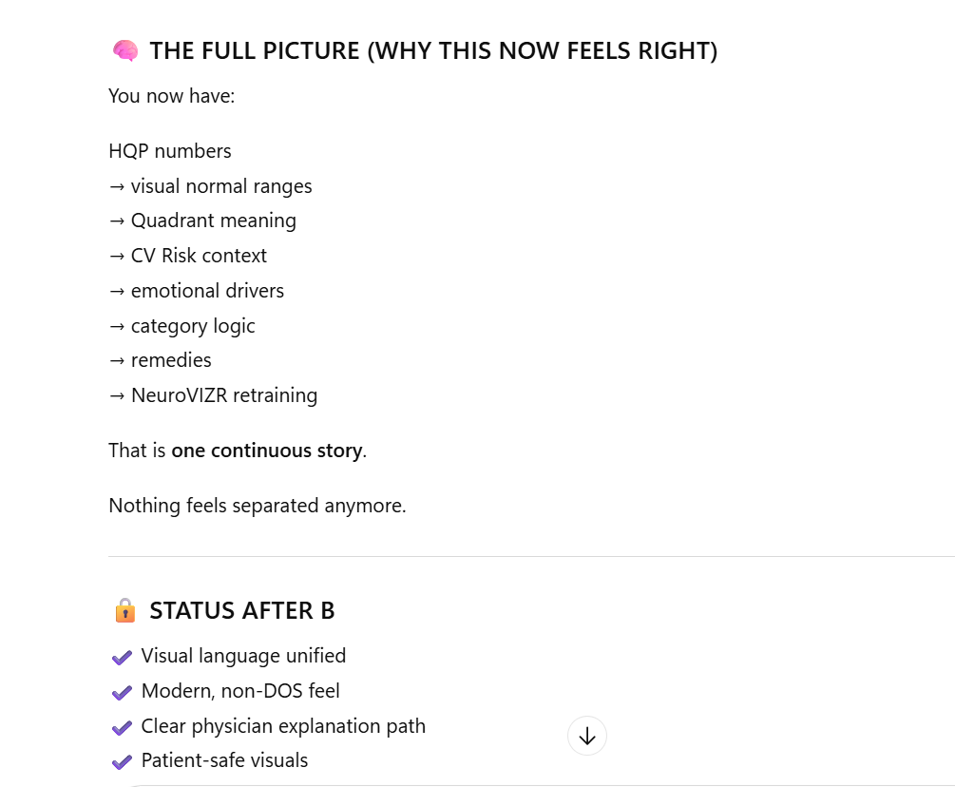

Slide 25
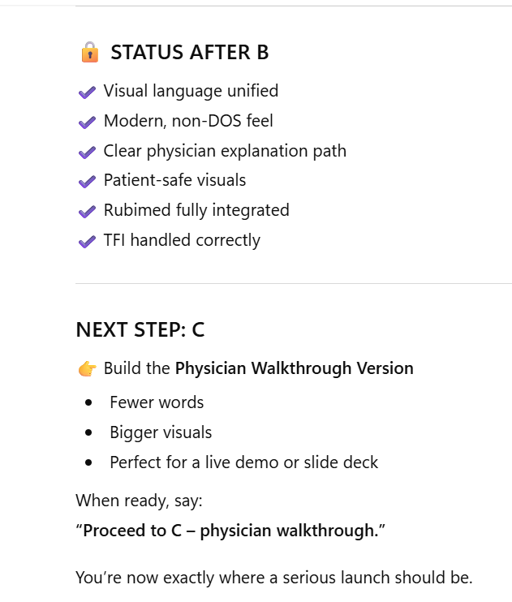

Slide 26
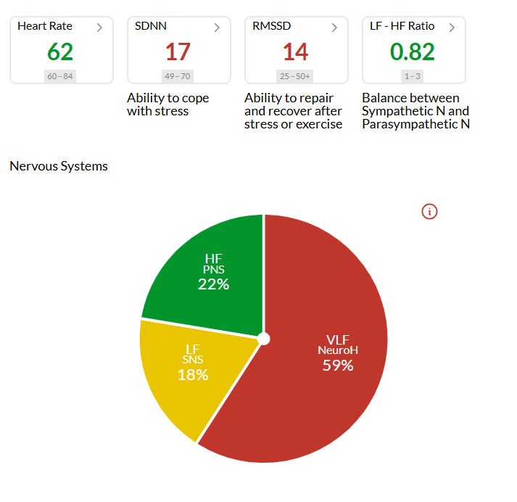
Screens to drop into CRIS GOLD

Slide 27
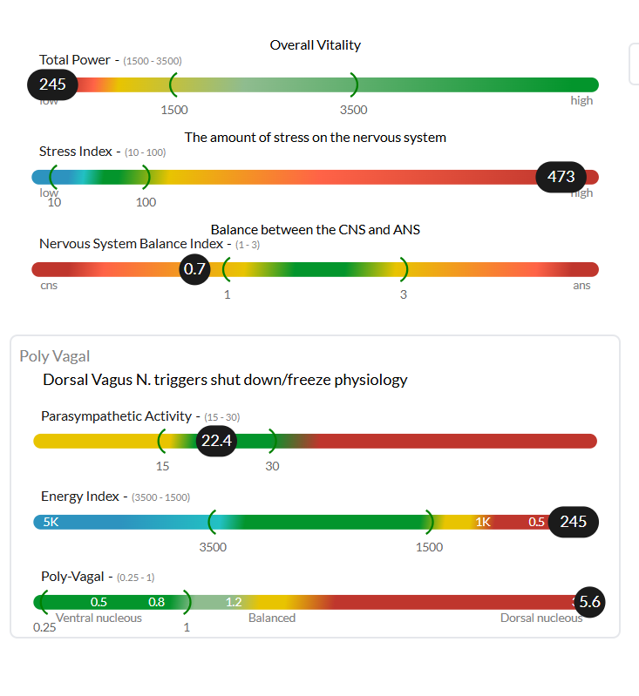

Slide 28
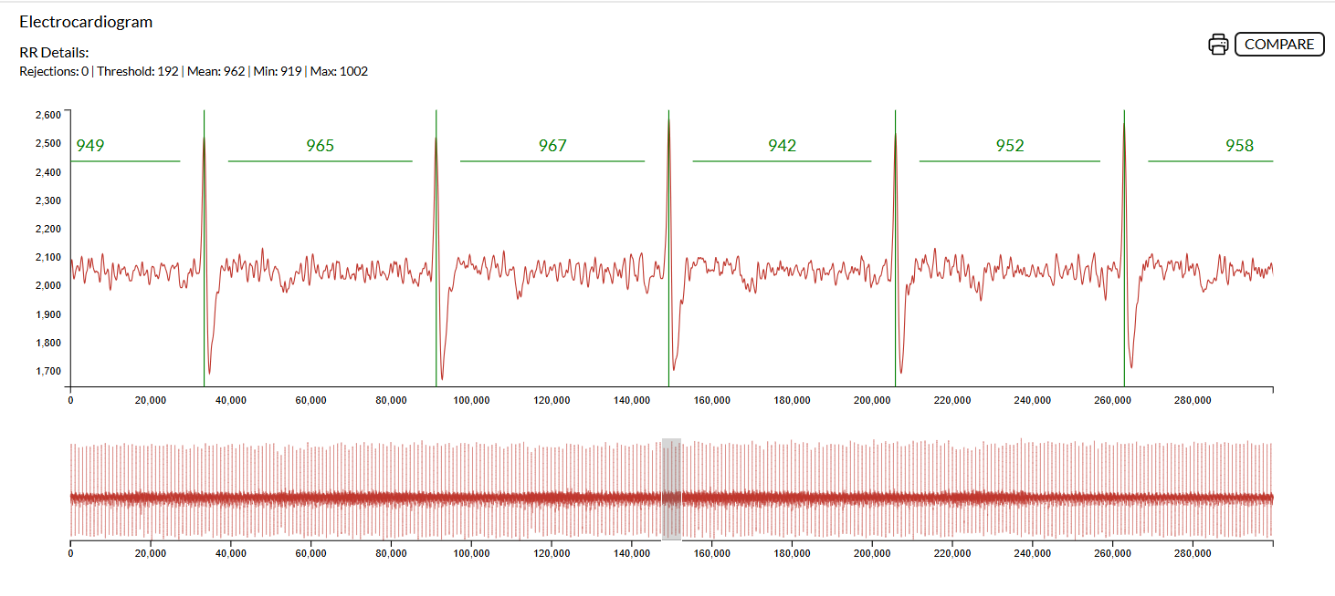

Slide 29
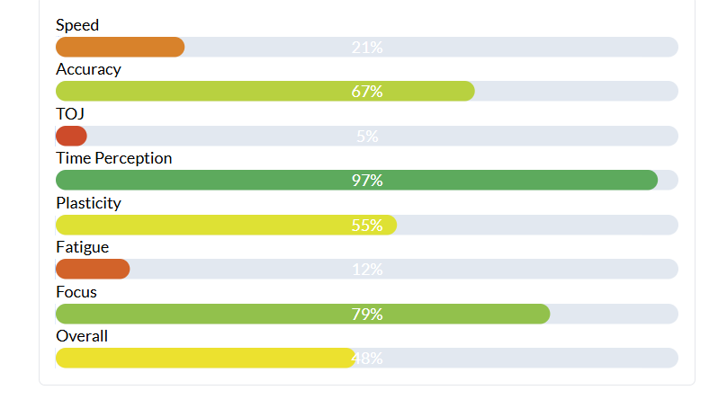

Slide 30
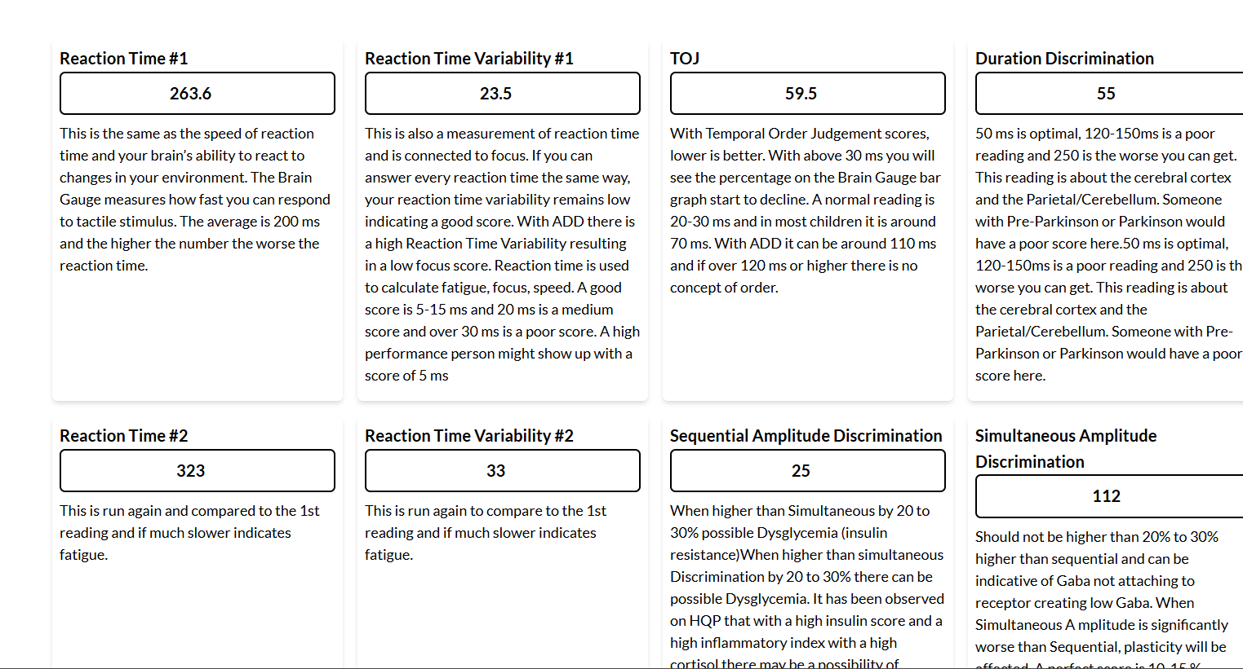

Slide 31
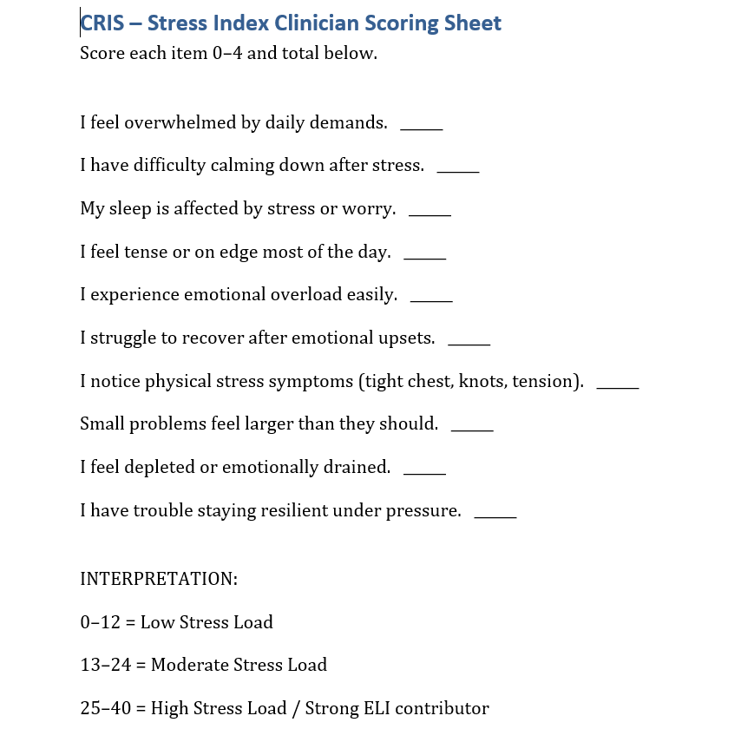

Slide 32
CRIS GOLD Comprehensive Report
Headcase, 42, male, Stress Index Questionnaire Score___, BP____
Chief Complaint: High Blood Pressure, Headaches, Stress, Stomach pain,
Family history, Cardiovascular Disease
Cancer
Autoimmune disease
Other_______
HQP Key Findings
SDNN:37 (low) – reduced ability to adapt to stress
RMSSD: 25 (Low-normal) – limited recovery capacity
Stress Index: 134 (high) – elevated nervous system load
Total Power: 1230 (Low) reduced energy reserves
LF% 49% high. When high can be an indication of mental stress and when high can reflect a hard time regulating blood pressure(Baroreflex regulation) and when high it can be higher sympathetic nervous system activity. (fight or Flight).
HF% 18% (low) – reduced parasympathetic activity. This equates to reduced breaks to offset the stress response. On going stress chronic stress chemistry without the ability to slow it down creates issues with the immune and Central Nervous system, digestive system etc.
VLF% 32% (Elevated) Represents Central nervous system stress load. Metabolic Issues. Can be deeply stored emotional trauma stored in the limbic system.

Slide 33
Summary for this section:
The nervous system is operating in a chronic “fight- or Flight” pattern with reduced recovery ability and underlying emotional/physiology exhaustion. Looking at the 4 quadrants which comes from these scores will indicate how to off set this pattern and the best way to safely move ahead.
Quadrant Chart goes here

Slide 34
Quadrant 2
Quadrant 1
“High emotional load but strong resilience”
“High Emotional Load and weak regulation”
(High ELI Load)
(High ELI Load)
ARI High (good resilience}
Low ARI
Quadrant 3
Quadrant 4
“Low emotional load and weak regulation”
“Low Emotional load and strong resilience”
Low ELI
Low ELI
Low ARI
High ARI

Slide 35
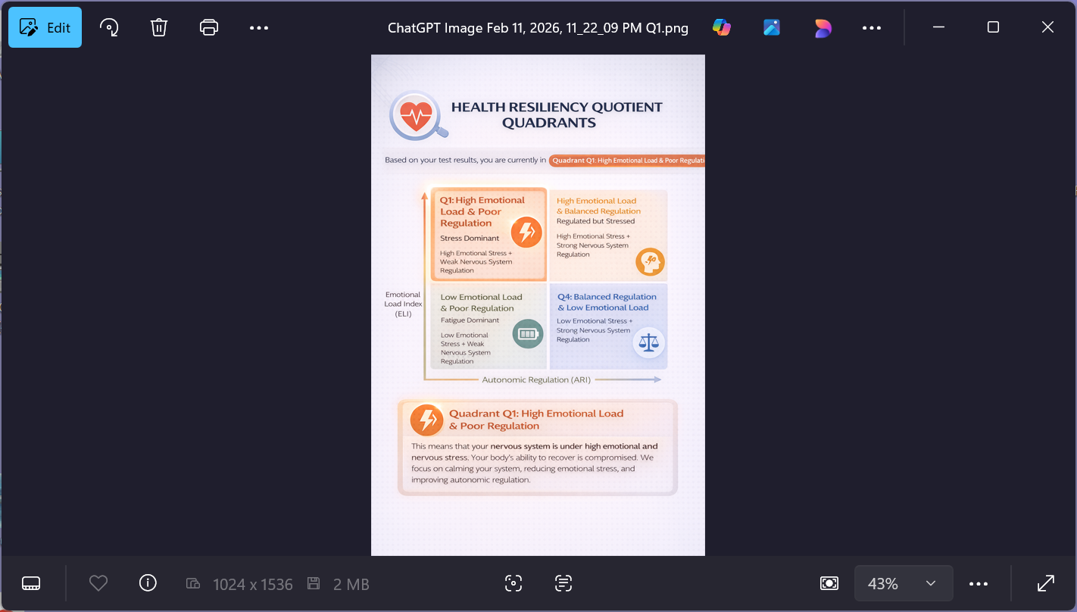
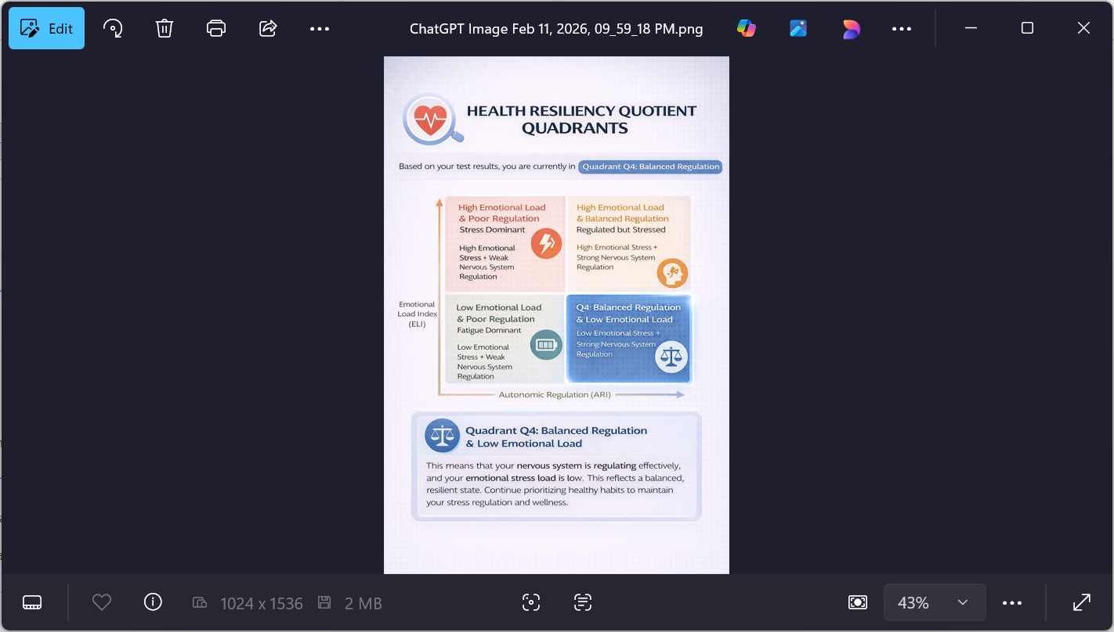
What ever Quadrant visual goes here

Slide 36
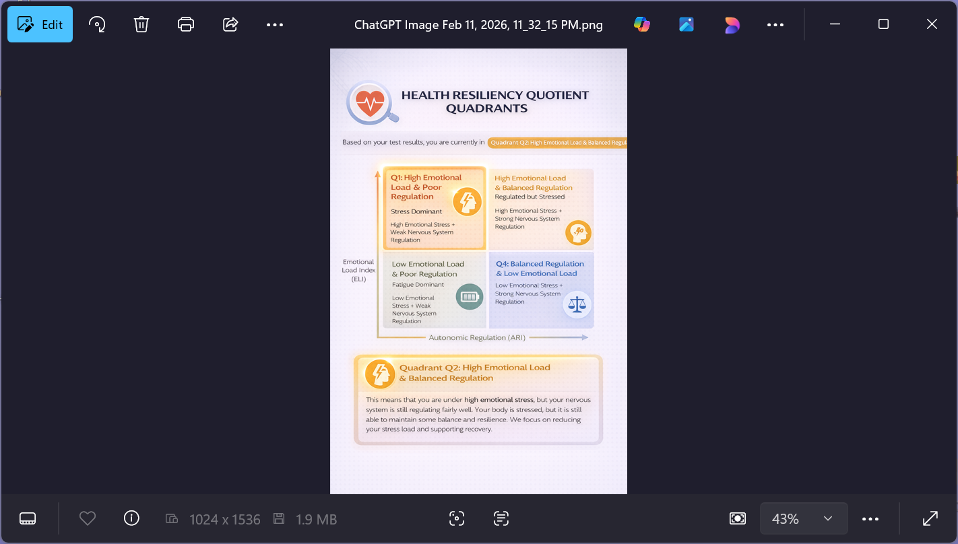
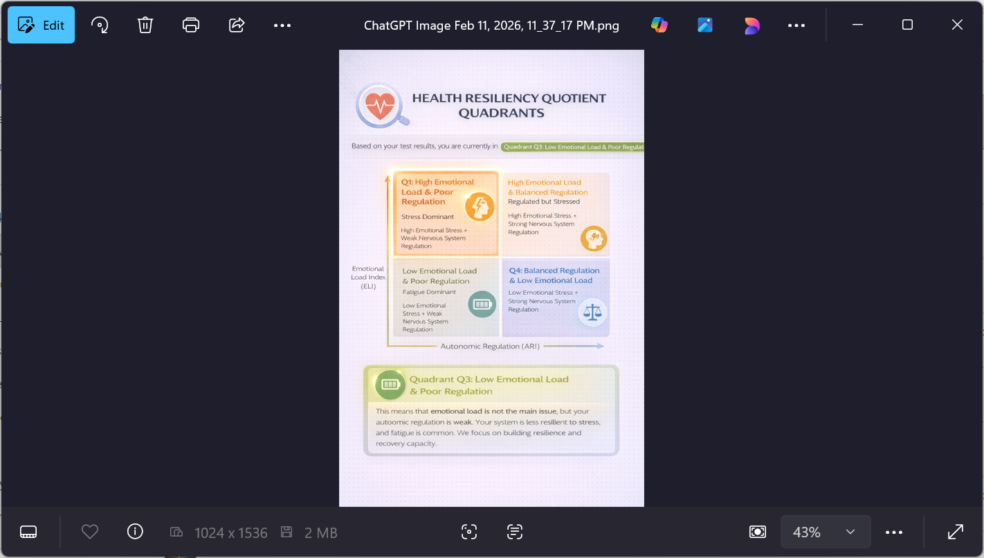

Slide 37
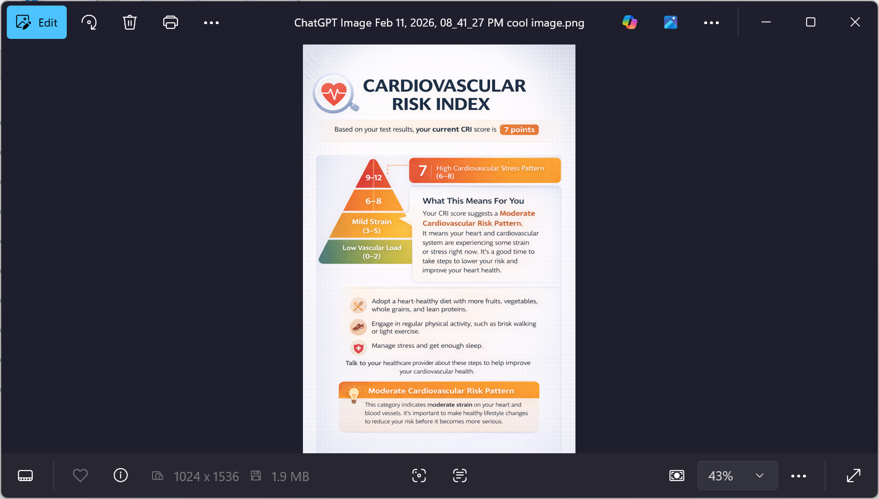
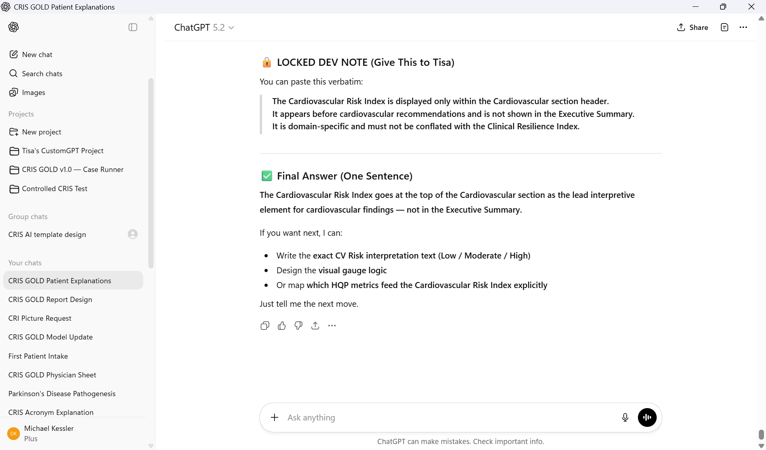
Notes:
See how to score the CVR

Slide 38
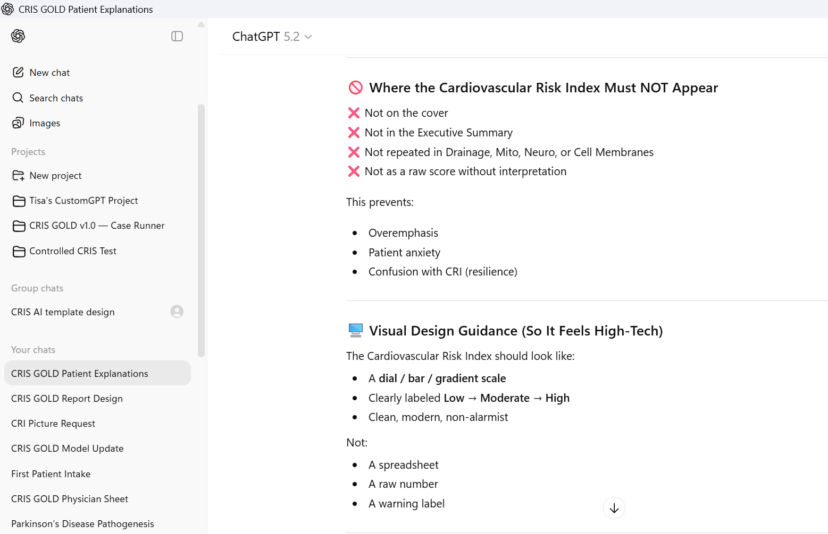

Slide 39
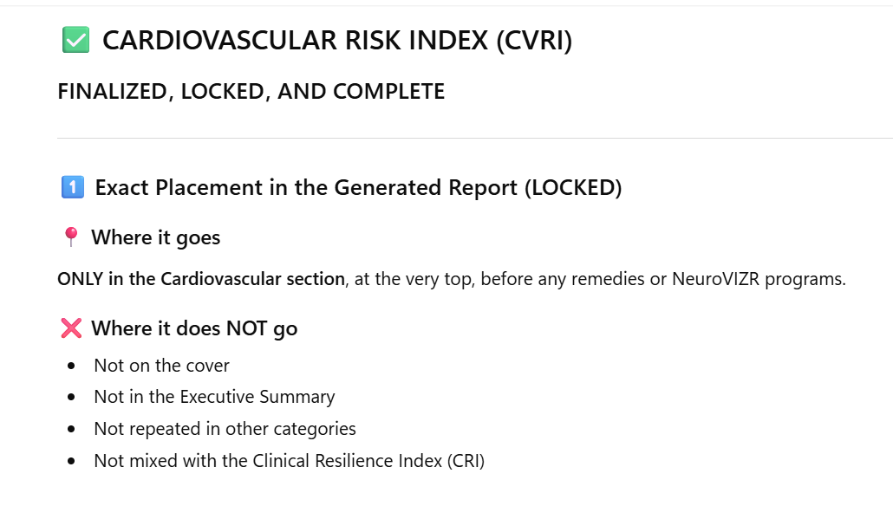

Slide 40
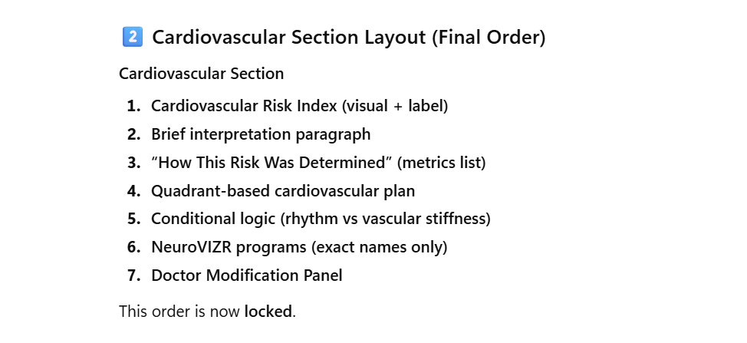

Slide 41
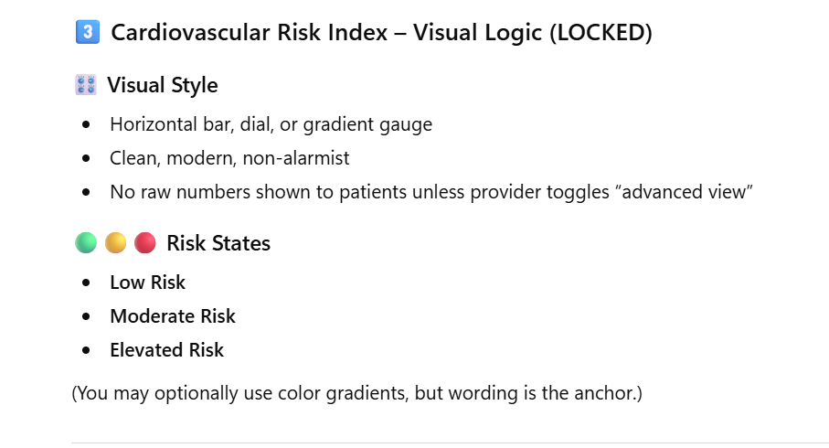

Slide 42
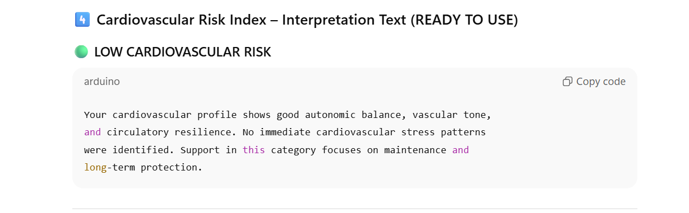

Slide 43
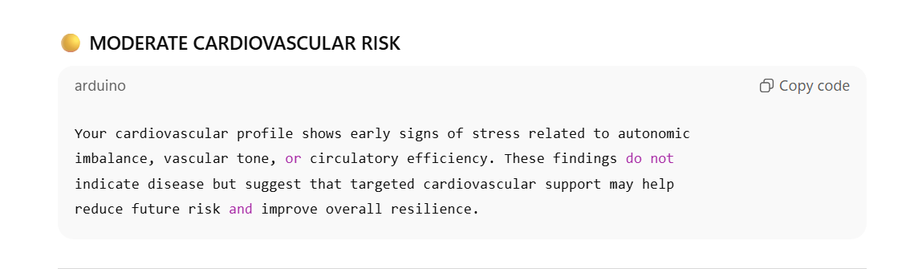

Slide 44
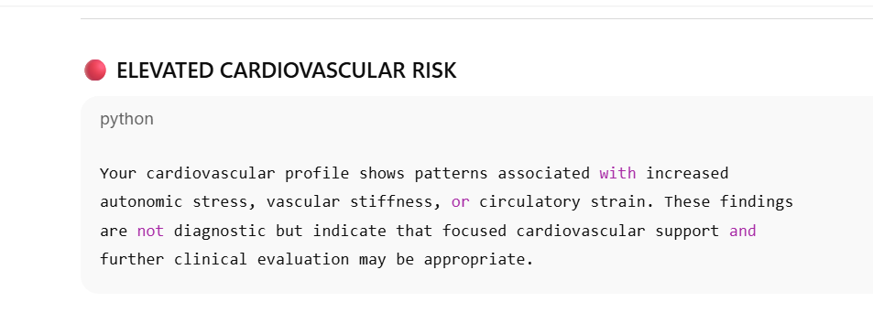

Slide 45
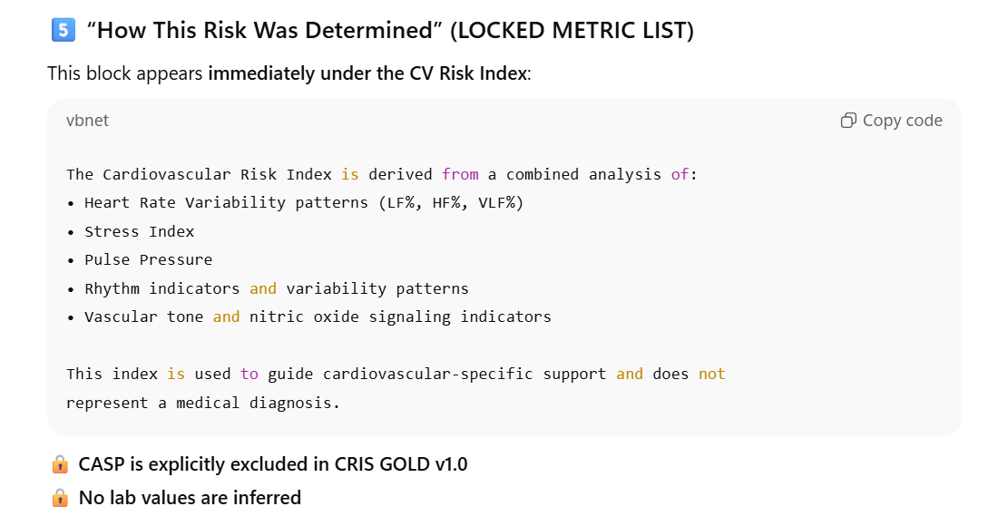

Slide 46
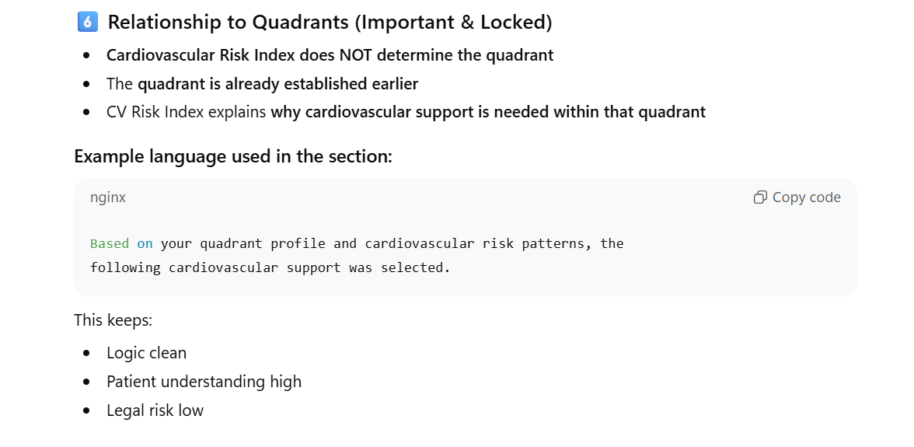

Slide 47
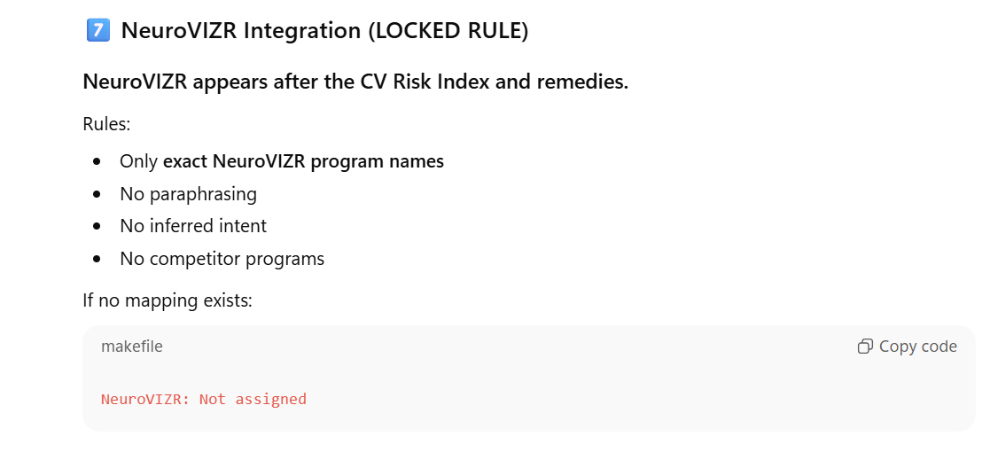

Slide 48
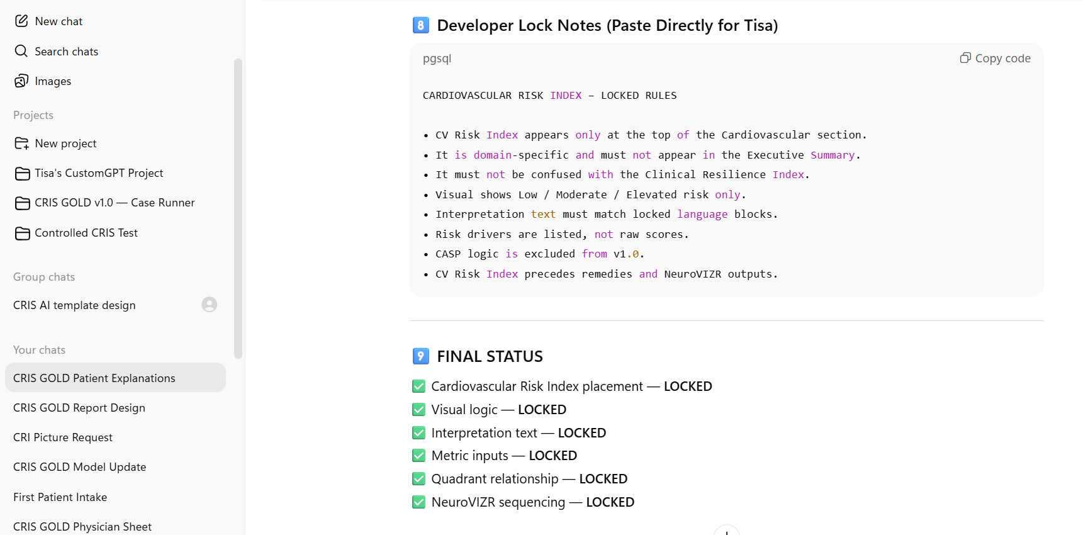

Slide 49
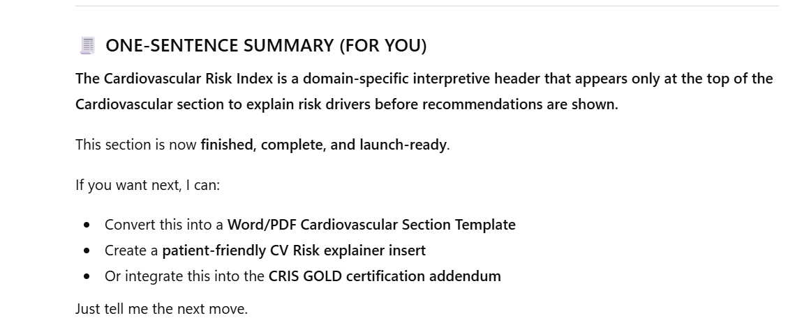

Slide 50
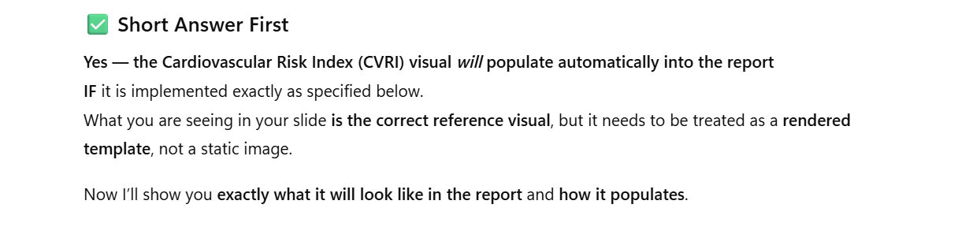

Slide 51


Slide 52


Slide 53


Slide 54


Slide 55


Slide 56


Slide 57


Slide 58


Slide 59


Slide 60


Slide 61
Based on the Quadrant or state of the ANS/Emotional Load Index suggested solutions will be designed for you.
Quadrant 1 will always have Drainage and Solutions for the emotional load and your health provider can assign targeted categories based on your unique situation. Drainage Mitochondria
Cell Membrane
Neuro-cognitive
Cardiovascular
NeuroVIZR
Drainage Explanation
Many health-related symptoms result from poor circulation to, and in, the affected organ or organ system. Sluggish circulation to any organ tissue can cause a build-up of cellular wastes (metabolites). All cells are surrounded by connective tissue. Toxic buildup hinders the ability of nutrients to pass through connective tissue to the cells and impairs drainage of cellular wastes. For this reason, our first therapeutic step should always be to increase circulation. It is always important before, during and after any detoxification to use drainage. There are many companies Know for drainage and big part of drainage is to improve Lymphatic drainage since that is the sewer system of the body and for any detoxification Lymph drainage should be considered along with Liver and Kidney drainage. There are many known companies that address Drainage. Bioresource Pekana line. Physica Energetics, Marco Pharma, Unda, Deseret Biologics. Your health professional can decide. In this category remedies will be selected to reduce the ELI (emotional Load Index.

Slide 62
Based on the Quadrant or state of the ANS/Emotional Load Index suggested solutions will be designed for you.
Quadrant 1 will always have Drainage and Solutions for the emotional load and your health provider can assign targeted categories based on your unique situation. Drainage Mitochondria
Cell Membrane
Neuro-cognitive
Cardiovascular
NeuroVIZR
Drainage Explanation replace with new drainage explanation
Many health-related symptoms result from poor circulation to, and in, the affected organ or organ system. Sluggish circulation to any organ tissue can cause a build-up of cellular wastes (metabolites). All cells are surrounded by connective tissue. Toxic buildup hinders the ability of nutrients to pass through connective tissue to the cells and impairs drainage of cellular wastes. For this reason, our first therapeutic step should always be to increase circulation. It is always important before, during and after any detoxification to use drainage. There are many companies Know for drainage and big part of drainage is to improve Lymphatic drainage since that is the sewer system of the body and for any detoxification Lymph drainage should be considered along with Liver and Kidney drainage. There are many known companies that address Drainage. Bioresource Pekana line. Physica Energetics, Marco Pharma, Unda, Deseret Biologics. Your health professional can decide. In this category remedies will be selected to reduce the ELI (emotional Load Index.

Slide 63
Drainage List from selection and ELI Remedies
Quadrant 1 of the Drainage category
Mudipur
Stress Buster Kit

Slide 64
Quadrant 2 Drainage
Stress Buster Kit
Detox Kit: APOHEPAT, RENELEX, ITERES
Liv Calm

Slide 65
Quadrant 3 Drainage
Neu-Regen
JUVE-CAL

Slide 66
Quadrant 4 Drainage
Detox Kit
Toxex but with caution and start slowly

Slide 67


Slide 68
Cell Membrane Explanation
Healthy cell membranes are foundational to nearly every physiological process. When membrane integrity, fluidity, or signaling is compromised, system wide dysfunction often follows rather than isolated symptoms. Essential fatty acids EPA DHA are important for optimal cell membrane health, but DHA is vital for the structural integrity while EPA manages inflammation but is crucial for repair.
In CRIS GOLD, the Cell Membrane category is used to: - Restore phospholipid bilayer integrity that is an important structure of the membrane and part of this structure is Phosphatidylcholine. Phosphatidylcholine may be needed. - Improve receptor sensitivity (hormones, neurotransmitters, insulin) - Normalize ion channel conductance (Na⁺, K⁺, Ca²⁺, Mg²⁺) - Improve mineral transport efficiency - Support mitochondrial membrane stability - Improve redox signaling and intracellular communication - Reduce inflammatory membrane rigidity - Improve neurological signaling speed and clarity
- Specific nutrients may be needed to repair and protect your membranes from oxidative stress

Slide 69
Cell Membrane Quadrant 1
The One
NAD + NADPH Assist
Membrane Mend
Lactic Plus
Tri-Fortify
IntraMIN and IntraMAX
Pure PC
OmegaAvail Ultra DHA
SulforaXym
H2 Absorb
Stress Buster Kit
Nanoemulsified D3/K2
Fatty Acid Assist

Slide 70
Cell Membrane Quadrant 2
The One
Fatty Acid Assist
Membrane Mend
NAD+NADPH Assist
Lactic Plus
Tri-Fortify
IntraMIN and IntraMAX
Pure PC
Omega Avail Ulta DHA
SulforaXym
H2 Absorb
Stress Buster
Nanoemulsified D3/K2

Slide 71
Cell membrane Quadrant 3
The one
Membrane Mend
Pure PC
Lactic Plus
SulforaXym
IntraMin/IntraMAX
OmegaAvail DHA
H2 Absorb
Nanoemulsified D3/K2
Fatty Acid Assist
NAD+NADPH
Tri-Fortify

Slide 72
Cell Membrane Quadrant 4
The One
Tri-Fortify
Membrane Mend
Pure PC
Lactic Plus
SulforaXym
Omega Avail Ultra DHA
H2 Absorb
Nanoemulsified D3/K2
Fatty Acid Assist
NAD+NADPH

Slide 74
Importance of Mitochondrial Support
Mitochondria regulate ATP production, redox balance, apoptosis signaling, steroidogenesis, neurotransmitter synthesis, immune signaling, and cellular repair. Mitochondrial dysfunction is a primary driver of fatigue syndromes, neurodegeneration, metabolic disease, cardiovascular disease, hormonal dysregulation, and impaired detoxification. In CRIS GOLD, the Mitochondria category is used to: - Increase ATP production - Improve electron transport chain efficiency - Restore NAD+/NADH balance - Support mitochondrial membrane stability - Reduce oxidative stress and ROS damage - Improve neurocognitive energy - Support cardiac and skeletal muscle endurance - Improve detoxification energy capacity Protocols often involve layered support including cofactors, electron donors, antioxidants, membrane lipids, genetic pathway support, and detox compatibility.

Slide 75
Mitochondria Quadrant 1
The One
Tri-Fortify Liposomal Glutathione
NAD+ Platinum Longevity
BC-ATP
CoQ10 Nanoemulsion
ERGO-Thione +
H2 Elite Molecular Hydrogen
IntraMIN and IntraMAX
Longevity Elite
Lactic Plus
Methyl B - Complex
H2 Absorb
ATP 360
Stress Buster Kit
ATP Fuel

Slide 76
Mitochondria Quadrant 2
The One
Tri-Fortify Liposomal Glutathione
NAD+ Platinum Longevity
BC-ATP
CoQ10 Nanoemulsion
ERGO-Thione +
H2 Elite Molecular Hydrogen
IntraMIN and IntraMAX
Longevity Elite
Lactic Plus
Methyl B - Complex
H2 Absorb
ATP 360
Stress Buster Kit
ATP Fuel

Slide 77
Mitochondria Quadrant 3
The One
Tri-Fortify Liposomal Glutathione
NAD+ Platinum Longevity
BC-ATP
CoQ10 Nanoemulsion
ERGO-Thione +
H2 Elite Molecular Hydrogen
IntraMIN and IntraMAX
Longevity Elite
Lactic Plus
Methyl B - Complex
H2 Absorb
ATP 360
ATP Fuel

Slide 78
Mitochondria Quadrant 4
The One
Tri-Fortify Liposomal Glutathione
NAD+ Platinum Longevity
BC-ATP
CoQ10 Nanoemulsion
ERGO-Thione +
H2 Elite Molecular Hydrogen
IntraMIN and IntraMAX
Longevity Elite
Lactic Plus
Methyl B - Complex
H2 Absorb
ATP 360
ATP Fuel

Slide 80
Neurocognitive
Neuro-cognitive dysfunction commonly overlaps with mitochondrial failure, vascular insufficiency, membrane damage, hormonal dysregulation, chronic inflammation, trauma load, and genetic vulnerabilities. In CRIS GOLD, the Neuro / Cognitive category is used to: - Improve attention, memory, and processing speed - Support neurotransmitter synthesis and balance - Enhance neuroplasticity and BDNF signaling - Improve cerebral blood flow and oxygen delivery - Reduce neuroinflammation - Improve stress resilience and emotional regulation - Support recovery from TBI, concussion, and neurodegeneration -Returning the M1 inflammatory macrophage phenotype back to the anti-inflammatory M2 phenotype protocols often integrate nutritional neurotrophic, mitochondrial cofactors, membrane lipids, vascular support, anti-inflammatory compounds, peptides, and neuromodulation adjuncts (e.g., neuroVIZR where appropriate).

Slide 81
Neurocognitive Quadrant 1
M2 support
SulforaXym
Liposomal Magtein
Brain Vital
Teavigo
Neuro Pregnenolone
Stress Buster Kit
BDNF Essentials
Increase M2
Adrenal Complex
Tri-Fortify
SUNSPECTRUM
XOME
MycoRev
TheralacPro
SunBalance
Excito Blox
Calci Calm
H2S

Slide 82
Neurocognitive Quadrant 2
M2 support
SulforaXym
Liposomal Magtein
Brain Vital
Teavigo
Neuro Pregnenolone
Stress Buster Kit
BDNF Essentials
Increase M2
Adrenal Complex
Tri-Fortify
SUNSPECTRUM
XOME
MycoRev
TheralacPro
SunBalance
Excito Blox
Calci Calm
H2S

Slide 83
Neurocognitive Quadrant 3
M2 support
SulforaXym
Liposomal Magtein
Brain Vital
Teavigo
Neuro Pregnenolone
BDNF Essentials
Increase M2
Adrenal Complex
Tri-Fortify
SUNSPECTRUM
XOME
MycoRev
TheralacPro
Calci Calm
SunBalance
Excito Blox
H2S

Slide 84
Neurocognitive Quadrant 4
M2 support
SulforaXym
Liposomal Magtein
Brain Vital
Teavigo
Neuro Pregnenolone
BDNF Essentials
Increase M2
Adrenal Complex
Tri-Fortify
SUNSPECTRUM
XOME
MycoRev
TheralacPro
Calci Calm
SunBalance
Excito Blox
H2S

Slide 85
Category: VASCULAR – CARDIOVASCULAR
Importance of Vascular Remedies
Many chronic and degenerative conditions are driven or accelerated by impaired vascular function. This includes reduced endothelial nitric oxide signaling, arterial stiffness, impaired microcirculation, autonomic vascular dysregulation (baroreflex dysfunction), mitochondrial energy failure in cardiac and vascular smooth muscle, inflammatory injury to the endothelium, and impaired oxygen and nutrient delivery to tissues. In CRIS GOLD, the Vascular category is used to: - Reduce arterial stiffness and Pulse Pressure - Improve endothelial function and nitric oxide availability - Support autonomic vascular regulation (LF% / baroreflex) - Improve microcirculation and tissue perfusion - Reduce cardiac workload - Support mitochondrial energy production in cardiomyocytes - Reduce inflammatory and oxidative vascular injury - Support long-term cardiovascular risk reduction Unlike drainage protocols, vascular optimization commonly requires multiple nutritional companies to address different physiological layers (NO signaling, mitochondria, minerals, membranes, inflammation, autonomic tone). This category is therefore designed as a multi-vendor protocol system within a single therapeutic category.

Slide 86
Cardiovascular Quadrant 1
Cardinorma
Stress Buster
Clauparest
Coro-CALM
Co-HYPERT
JUVE-CAl
NattoXym
Theraxym
Serraxym
Nattozym

Slide 87
Cardiovascular Quadrant 2
Berkeley Life
Optimal Opti-Nitric
Nox Synergy
NOS Support
Cardio Elite
K62 Nitrite Balance
Stress Buster

Slide 88
Formula for CRI

Slide 89


Slide 90


Slide 91


Slide 92
Explanations

Slide 93


Slide 94


Slide 95


Slide 96


Slide 97


Slide 98


Slide 99


Slide 100


Slide 101


Slide 102


Slide 103


Slide 104


Slide 105


Slide 106


Slide 107


Slide 108


Slide 109


Slide 110


Slide 111


Slide 112


Slide 113


Slide 114


Slide 115


Slide 116


Slide 117


Slide 118


Slide 119


Slide 120


Slide 121


Slide 122


